Slide 1
Anomaly Detection
Comparison of Deep SVDD and Isolation Forest
Ömer Atmaca – 150220335

Slide 2
Problem
Lack of non normal data is a challenge to make the model learn representation of both normal data and anomalies.
Train the model with only normal data.

Slide 3
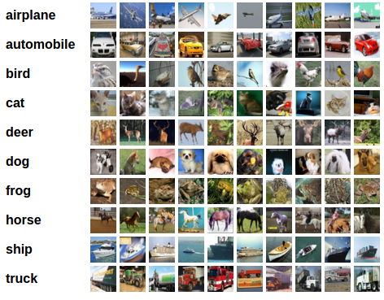
Data – CIFAR10
Images of objects such as airplane, horse, truck..
Select one object as normal and train the model with only the images of that object.

Slide 4
Deep SVD
Learns a transformation of input data using a neural network(Resnet) so that normal data points are mapped close to a center point in a latent space, while anomalies lie farther away. Network and SVDD are trained together so network learns to map images close to the center point.
One Class and Soft Boundary:
  One Class SVDD is less tolerant to outliers in the training data. If your data is noisy or have outliers Soft Boundary SVDD might be a better idea.

Slide 5
Isolation Forest
Detects anomalies by randomly partitioning data and measuring how quickly a data point gets isolated. Anomalies are eaiser to isolate.
The features extracted by a neural network (ResNet) will be fed into the model.
Neural Network and forest wont be trained together.

Slide 6
Method of Comparison
Models will be trained with a higher learning rate and fewer epochs since Resnet is already pretrained.
Losses, training times and AUC(Area Under Curve) scores will be monitored to see how each model distinguish normal data and anomalies and how much time they need.

Slide 7
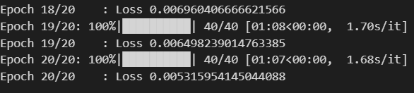
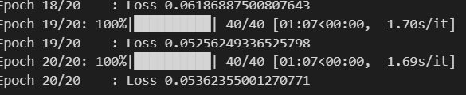
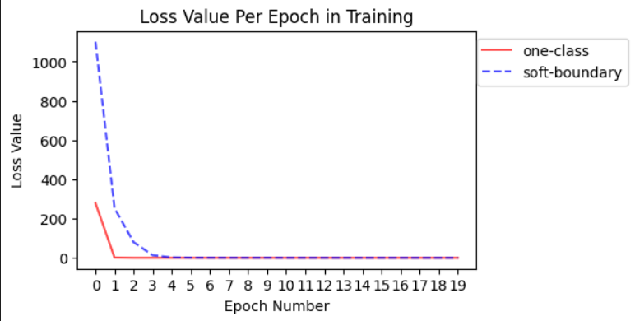
One Class and Soft Boundary Deep SVDD
One Class DSVDD
Soft Boundary DSVDD

Slide 8
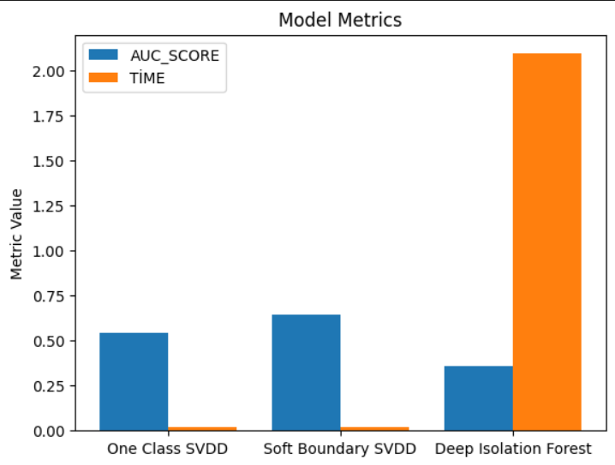
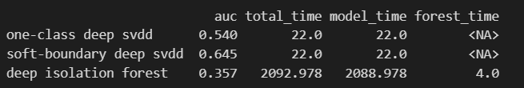
Final Comparisons

Slide 9
THANK YOU !!

